Slide 1
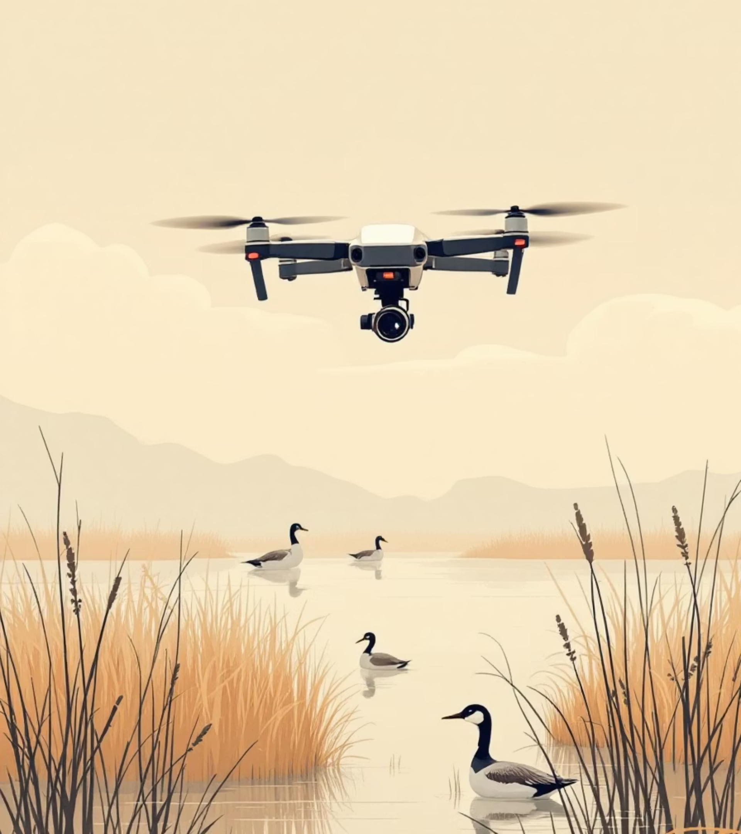
Portfolio 1
Computer Vision
Thermal UAV Waterfowl Detection and Analysis
Team members:
Rachitha Chandra Bhanu(10000726)
Sai Surya Mada(10000982)
Thota Bhuvana Chandra (10001026)

Slide 2
Assignment 1: Object Detection for Wildlife Conservation - Detecting Waterfowl in UAV Thermal Imagery
Problem Statement
Goal: Develop an object detection model to automatically identify waterfowl in UAV thermal imagery for wildlife conservation.
Challenge: Thermal bird signatures are tiny, low-contrast, and often to close, making accurate detection difficult.
Approach: Train a Faster R-CNN detector on thermal UAV images using a structured pipeline with dataset splitting, preprocessing, and targeted augmentations.

Slide 3
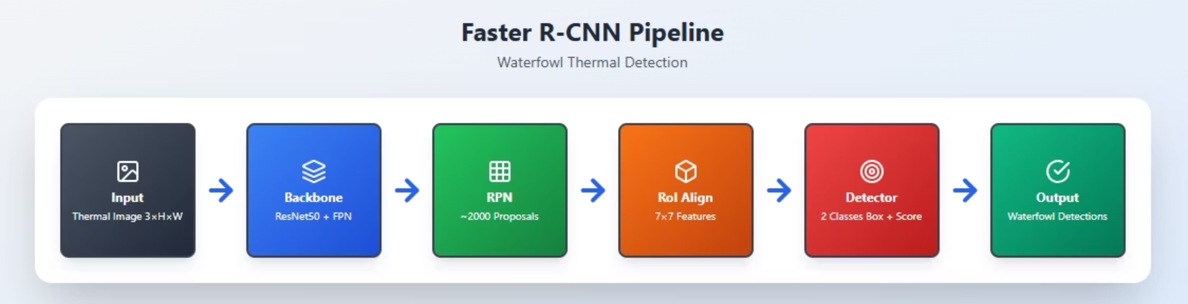
Faster RCNN

Slide 4
Training Pipeline Using Faster R-CNN
Selected Faster R-CNN (ResNet50-FPN) object detection model.
Performed dataset split: 60% train, 20% val, 20% test.
Used thermal images as primary input.
Applied domain-specific augmentations:
Random horizontal flip
Light Gaussian blur
Included both positive and negative samples to reduce false detections.
Trained for 15 epochs using AdamW + LR scheduling.

Slide 5
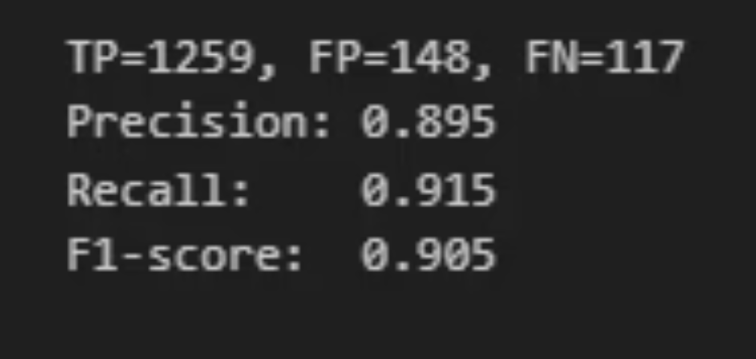
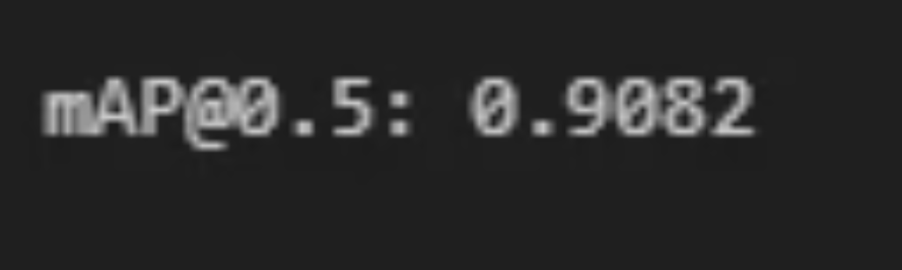
Results & Evaluation
Model detects most waterfowl despite their small size.
Strengths:
High recall - detects majority of birds
Good precision - relatively few false detections
Weaknesses:
Some false positives on noisy thermal hotspots
Slight over-detection in clustered bird areas

Slide 6
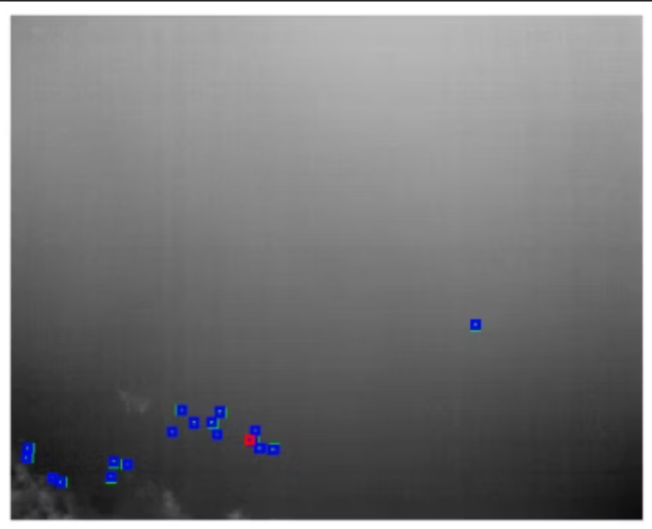
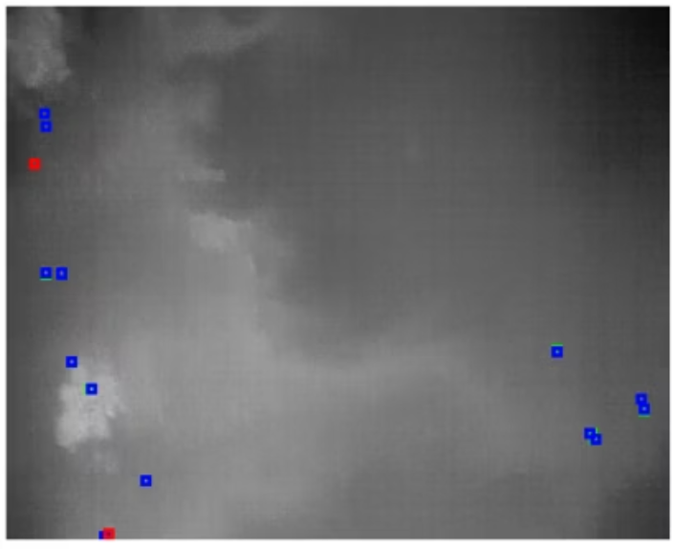
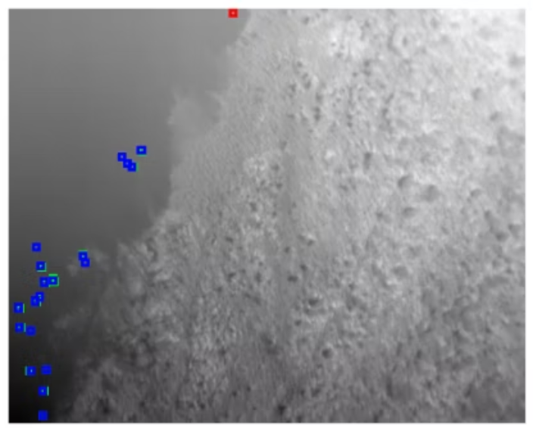
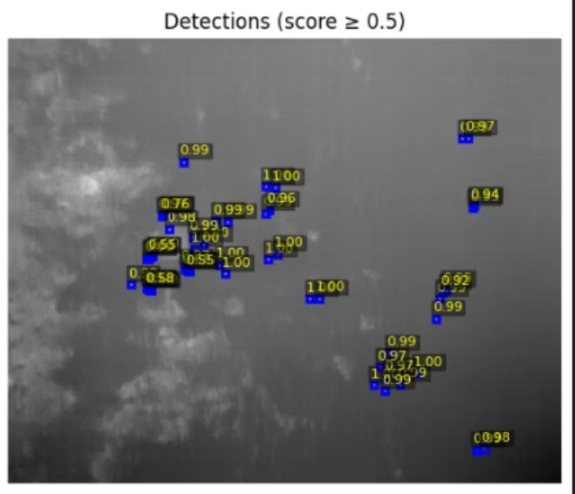
Visualization

Slide 7
Assignment 2: Deep Metric Learning for Waterfowl Detection and Conservation
Application
Goal
Wildlife conservation using thermal UAV imagery
Distinguish waterfowl species and detect non-bird objects
Key Topics:
Triplet loss training dynamics
Margin parameter effects
Out-of-distribution detection

Slide 8

Triplet Loss Function
Formula
a: Anchor
p: Positive
Reference image
Same species
n: Negative
m: Margin
Different species
Parameter
Objective
d(a,n) ≥ d(a,p) + m

Slide 9

How Margin Controls Separation
Formula
Key Insights:
Direct control: Margin m sets minimum class separation
Dinter: Average between-class distance
Larger m → stronger class separation
Dintra: Average within-class distance
The margin directly increases required inter-class distance by exactly m

Slide 10




Problem: Margin Too Large
Critical Condition
Consequences:
Infeasible constraint
No convergence
Training stalls
Cannot be satisfied geometrically
Loss stays positive (ℒ > 0)
Optimization leads nowhere
Example
If embeddings on unit sphere (dmax = 2) and m = 3, constraint impossible since 2 < 2 + 3

Slide 11
Problem: Margin Too Small
This is when you set a "safety gap" that is practically useless.
The "Lazy" Triplet Example:
Anchor (a): A thermal image of a Mallard.
Positive (p): Another thermal image of the same Mallard. Model places them close: d(a,p) = 0.5.
Negative (n): A thermal image of a Coot. Model is "lazy" and places it very close: d(a,n) = 0.6.
Tiny Margin (m): You set m = 0.05.
Loss Calculation:
The clusters for Mallards and Coots are almost touching. This leads to an "overlapping mess" where the model cannot reliably distinguish between species.

Slide 12
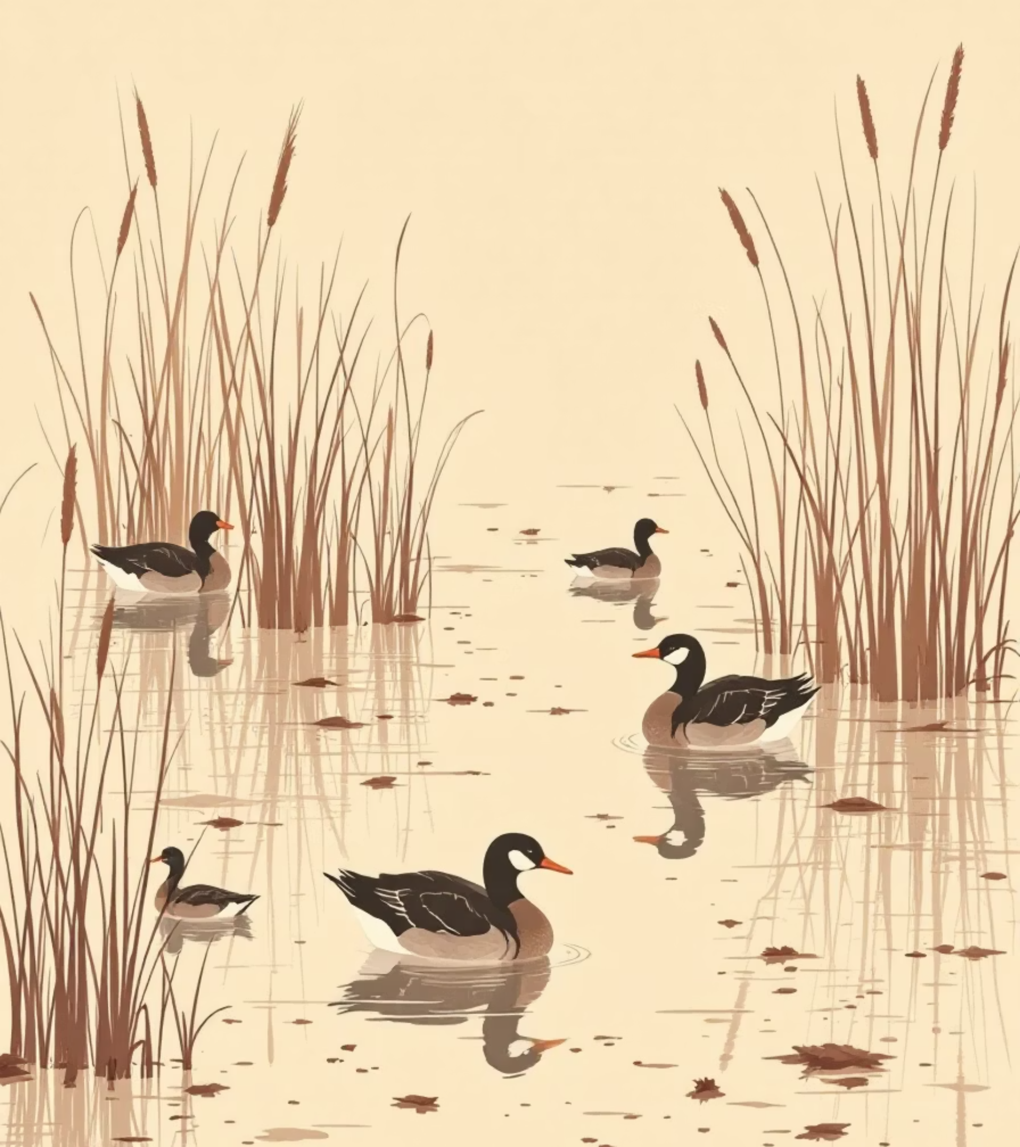
Out-of-Distribution Detection
In-Distribution (ID)
Out-of-Distribution (OOD)
Known waterfowl species
Vegetation
Trained classes
Water reflections
Debris
Other animals
Goal: Automatically detect when thermal image is NOT a waterfowl

Slide 13
OOD Detection: 5-Step Method
01
02
03
Compute class prototypes
Measure distance to nearest prototype
Compute class radii
μc = average embedding per species
rc = max distance within class
04
05
Calculate OOD score
Apply threshold
minc ‖f(x) - μc‖
If score > τ → OOD

Slide 14
OOD Score Calculation
Basic Score:
Robust Version:
Interpretation
Small score → Close to known species → ID
Large score → Far from all species → OOD

Slide 15
Thank You

